Slide 1


Seeds4Kids 2026 / 27
Sponsored by:
The Lottbridge Golf Club Friendliest Club on the South Coast
Devised & delivered by:
Treebourne
About The Project & How To Apply
Funded by the Lottbridge Golf Club, delivered by Treebourne

Slide 2

Mission Statement
To teach children about trees - how important they are and about their place in our ecosystem
To show them how to identify trees and understand their life cycle
To engage them in the wonders of growing trees from seeds

Slide 3
How We Achieve Our Mission Statement
OUR S4K KIT CONTAINS…
All you need to teach children how to identify trees, collect their seeds, then germinate and grow the seeds into beautiful trees.
OUR TREEBOURNE.ORG WEBSITE CONTAINS…
Printable handouts and information on the topics below, alongside links to useful sites.
Identifying trees
Tree species life cycles, from seed to planting out
Species characteristics useful for knowing where and when to plant.

Slide 4
Our Story So Far
In 2021 Ray Cruttenden from the LOTTBRIDGE GOLF CLUB contacted us to discuss how we could help him ENGAGE CHILDREN IN NATURE and encourage them to PLANT TREES to help COMBAT CLIMATE CHANGE.
From this, we developed a kit for Year 3 children based on school class sizes, but available for Youth Groups too, and called it SEEDS4KIDS.
It is not prescriptive, but allows you the freedom to design the best way of utilising the kit for your class / youth group
50 CLASSES ACROSS 5 SCHOOLS signed up for the project’s first year, and over 200 classes across 51 schools & youth groups took part in our second year. We then worked ‘hand-on’ with schools last year to refine the kit and the class process. Here’s some of the feedback we received:
‘The seed guides were great as they encouraged children to find a range of seeds and developed their independence and observation skills.’
‘The resource box was brilliant. The children loved the little pouches, and the information supplied was very clear and shall be re-used. Thank you!’
‘This was an amazing project that the kids loved! It was great to get out and about and so good for our mental health too!’

Slide 5
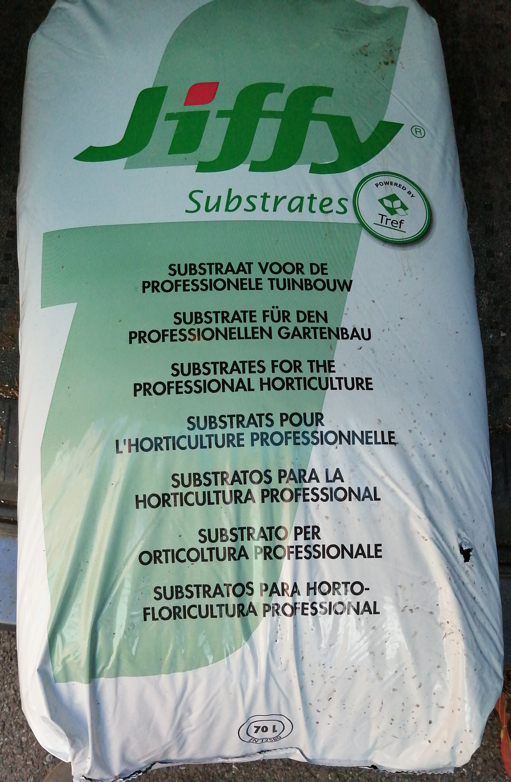
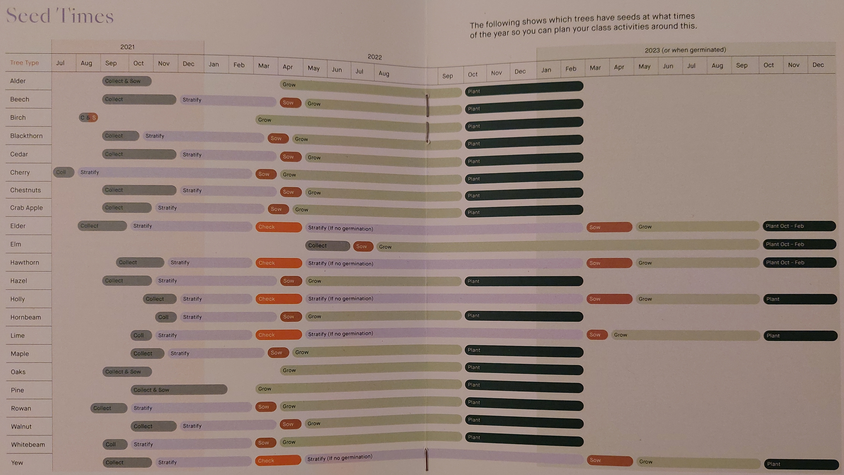
The S4K Kit
The kit is FREE and available for all schools and youth groups. It is aimed at supporting Forest School leaders. We recommend Year 3 children so they can watch their trees grow during their time in Junior school. But if you are a youth centre it can be any age – but we recommend ages where they will have 3 years to watch their trees grow.
It is not recommended for children under 5.
The S4K kit contains everything each child needs to
grow up to 12 trees, including:
Information for teachers / leaders Tree Identification guides for children to use to find their seeds Compost Seed trays – 1 between 2 Seedling labels Jug & Masher | Stratification box Linen bags Netting Biodegradable pots

Slide 6
Space & Where to Plant
SEEDS!
We do NOT provide seeds. One of the main, and most fun parts of the experience for children, is going out and identifying the trees and their seeds and collecting them to pot-up. We recommend a school trip to your local park but check out the types of trees they have first. Hampden Park and Sevenoaks Rec are great options. If you are not close and require transport, please contact us for support with this.
TO GROW
A class of 30 children, growing approx. 12 trees per child, requires 1.2 msq. of school or youth centre ground for the pots. This area needs to be in a sunny position and preferably sheltered.
If you do not have this area available, the success rate for growing seeds will be reduced.
TO PLANT
Once the trees are approx. 40cm they can be planted out. The children can do this…
At school
At home
Gift their trees to family and friends
Donate trees to Treebourne’s nurseries to be used in future projects around Eastbourne
We also have information on Where to Plant and How to Plant on our website.

Slide 7
Applying For The Kit
Visit TREEBOURNE.ORG/SCHOOLS and complete the application form at the bottom of the web page.
You can apply for any number of kits for the 2026 / 27 project up until the end of Friday 26th June 2026. Please remember to tell us how many children you have as the kits are bespoke.
The kits will be delivered during the 2nd and 3rd full weeks of September. This fits with the start of the school term, and the best time of year to collect tree seeds!
WHAT WE REQUIRE IN RETURN
That you answer 2 Google Form surveys a year (Dec & May); feedback is essential
If you do not use the kit, please let us know and we will collect it (unless you plan to use it the following year)

